Slide 1
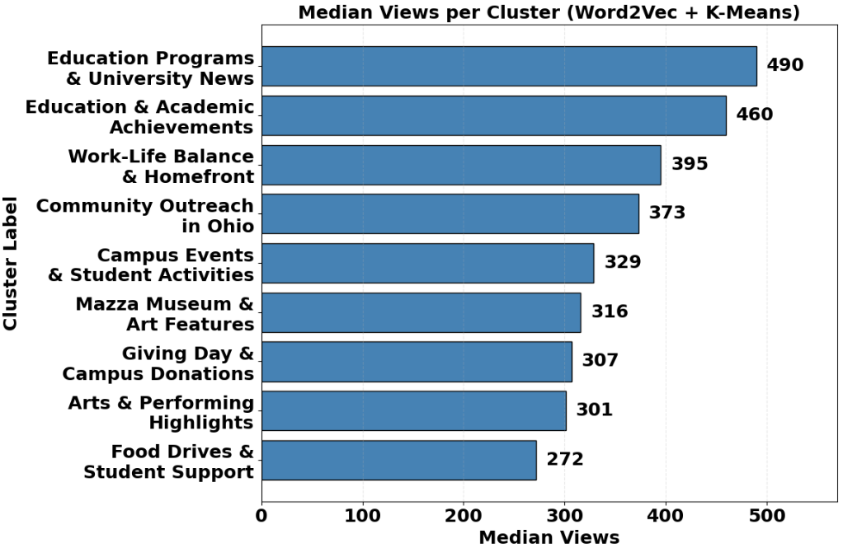
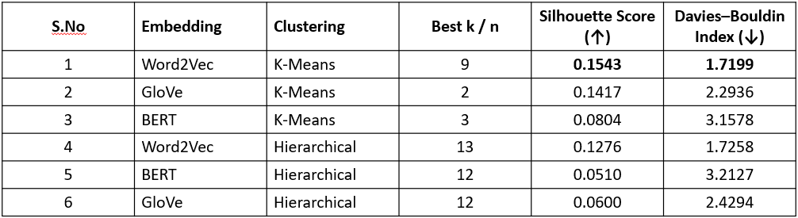
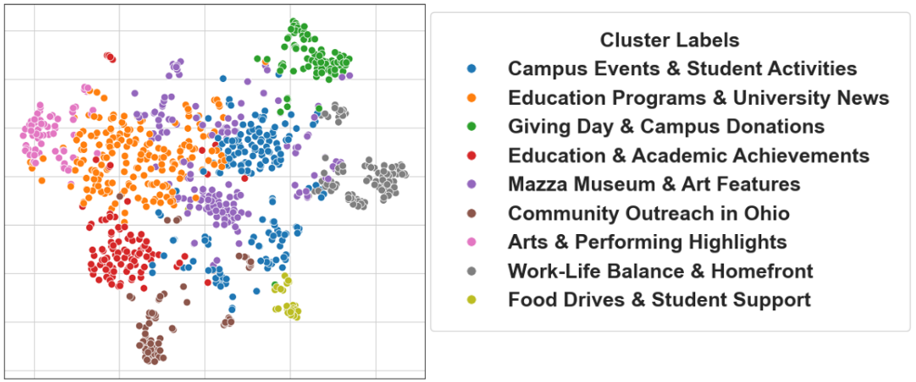
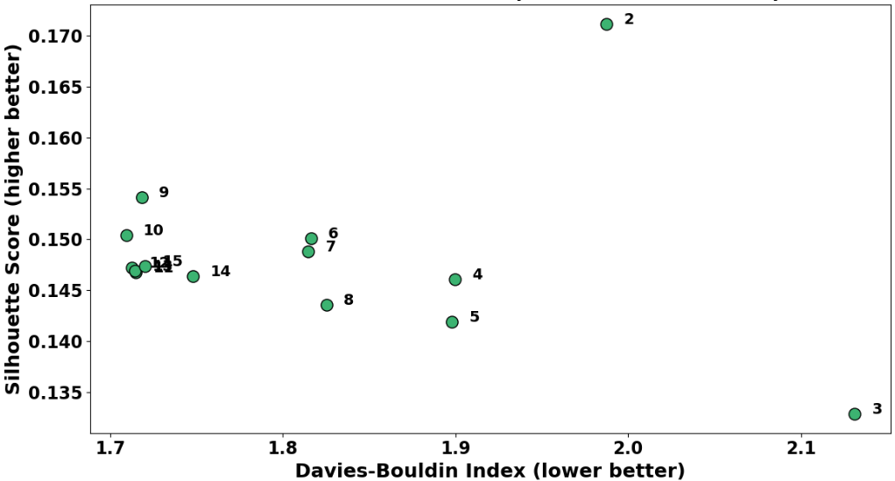
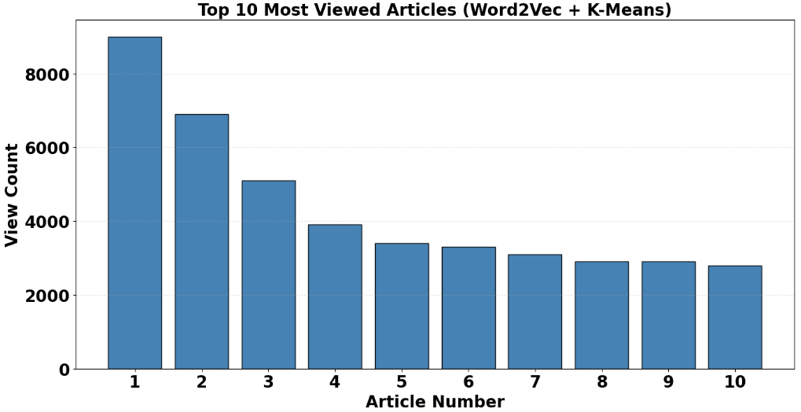
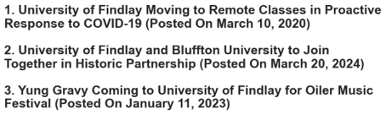
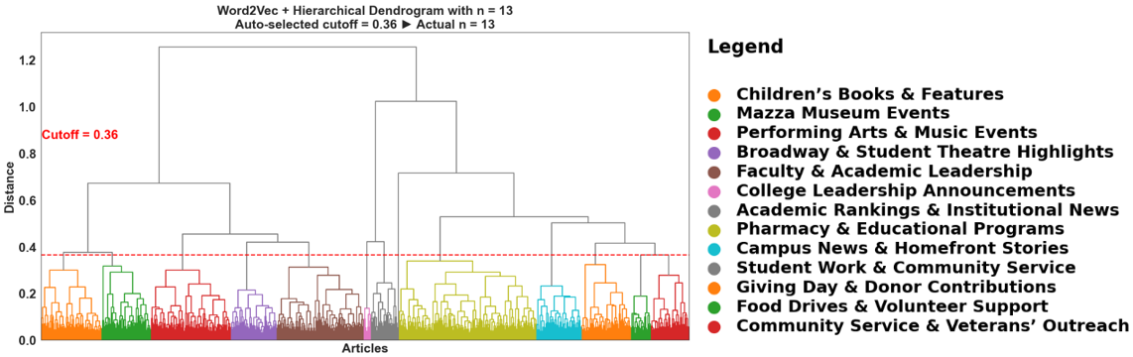
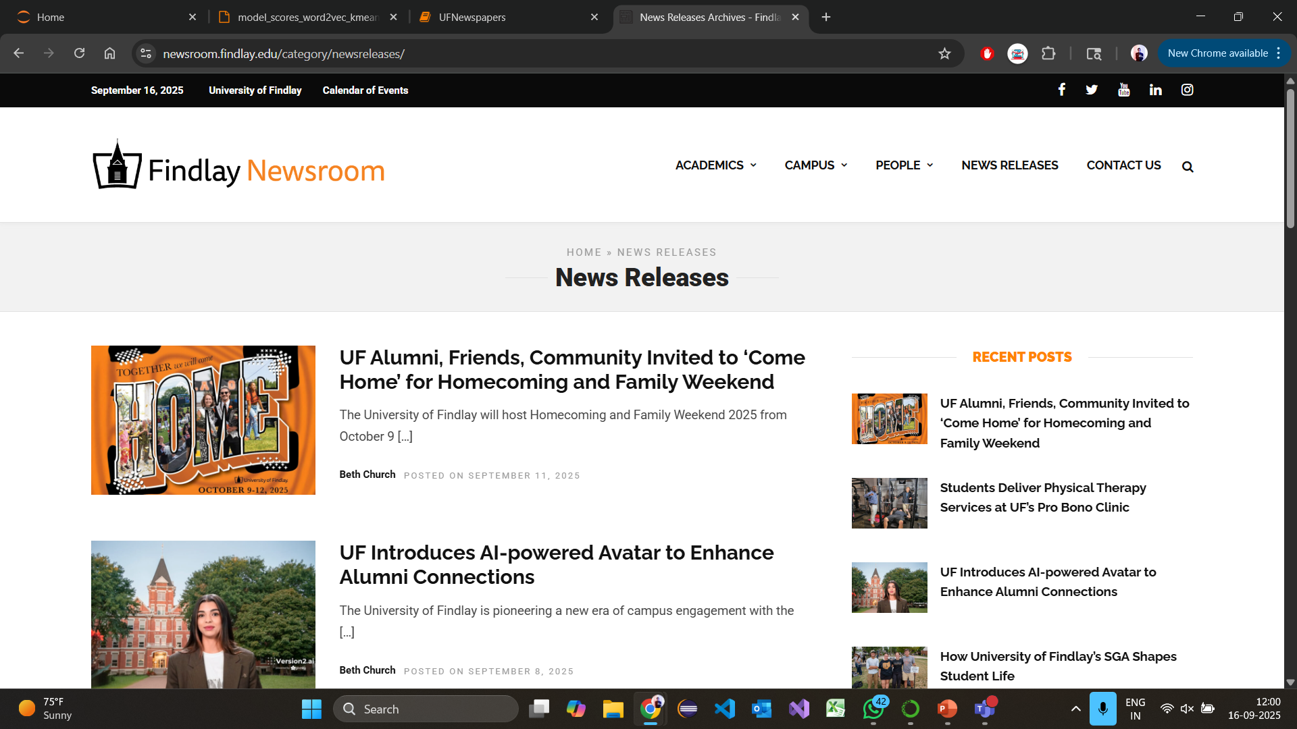
Comparison of Embedding Models for Clustering Findlay Newsroom Articles
Rohith Chakinarapu
Master of Science in Applied Security & Analytics
ABSTRACT
METHOD
RESULTS
This study analyzed over 1,000 archived articles from the University of Findlay Newsroom to evaluate the effectiveness of various text embedding and clustering techniques in uncovering communication themes and audience engagement patterns. Word2Vec, GloVe, and BERT embeddings combined with K-Means and Hierarchical Clustering were compared to assess cluster quality using Silhouette Score and Davies–Bouldin Index. The combination of Word2Vec and K-Means produced the most coherent and interpretable clusters, offering insights for enhancing institutional communication strategies.
Data Collection
Preprocessing
Embeddings:
Word2Vec, GloVe, BERT
Clustering:
K-Means, Hierarchical
Evaluation:
Silhouette Score, DB Index
Insights
Dimensionality Reduction and Visualization:
PCA, t-SNE
Figure 5: Clustering Results for Each Embedding and Clustering Combination
Figure 2: Workflow of Analysis Steps
Word2Vec + K-Means (k = 9) produced the clearest, most interpretable clusters with strong quantitative scores (Silhouette = 0.42, DBI = 0.79).
After data collection and preprocessing, the three embedding models tested for representation were:
  Word2Vec – captured local context
  GloVe – learned global co-occurrence patterns
  BERT – conducted deep contextual transformer embedding
Each embedding was clustered using:
  K-Means with cluster sizes k = 2–15
  Hierarchical Clustering with n = 2,7,13,15
Figure 8: Median Views per Cluster (Word2Vec +
K-Means)
INTRODUCTION
Median article views revealed Education Programs & University news - content themes attracted the most readers across UF Newsroom clusters.
Data were scraped from the University of Findlay Newsroom – News Releases using BeautifulSoup and Requests Python libraries. The corpus collected included article titles, dates, view counts and content. The articles were cleaned and processed using natural language processing techniques including removing stopwords, standardizing word forms (lemmatization), and handling names consistently (using a custom dictionary). The processed texts were then represented numerically using three text embedding methods—Word2Vec, GloVe, and BERT—to capture different levels of word meaning and context. These representations were grouped using two clustering techniques: K-Means, which partitions data into defined groups, and Hierarchical Clustering, which builds a tree-like structure of related topics. Cluster performance was evaluated using standard quality measures: Silhouette Score (how well articles fit their assigned group) and Davies–Bouldin Index (how distinct the groups are). Analyzing article view counts across these clusters revealed which topics drew the highest audience attention.
CONCLUSIONS
Figure 6: Overall Best Clusters of UF Newsroom Articles
Lightweight embeddings like Word2Vec outperform heavier models such as BERT on small institutional datasets.
K-Means delivers compact, well-separated clusters, while Hierarchical Clustering aids interpretability.
Quantitative metrics aligned with human interpretability, confirmed cluster validity.
Integrating text analytics with engagement data can help the University tailor news toward the themes that attract the most readers and strengthens data-driven communication strategy.
Each dot represents a UF Newsroom article positioned in 2D space using dimensionality reduction. Articles are grouped into 9 color-coded clusters based on semantic similarity using Word2Vec embeddings and K-Means (k=9). Cluster labels were assigned using top keywords and reflect dominant themes such as campus events, education, and community outreach.
Figure 3: Scatter Chart of Clustering Quality
Silhouette Score (higher is better) and Davies–Bouldin Index (lower is better) were used to select the best k values for Word2Vec + K-Means. Both metrics favored using K-Means with 9 clusters, as seen in Figure 3.
REFERENCES
Asudani, R., et al. (2023). Impact of Word Embedding Models on Text Analytics in Deep Learning Environment: A Review– https://pmc.ncbi.nlm.nih.gov/articles/PMC9944441/pdf/10462_2023_Article_10419.pdf
Zhang, Y., et al. (2024). From Word Vectors to Multimodal Embeddings: Techniques, Applications, and Future Directions for Large Language Models – https://arxiv.org/pdf/2411.05036
Wang, R. (2023). Revisiting GloVe, Word2Vec, and BERT: On the Homogeneity of Word Vectors – https://www.cs.toronto.edu/~rwang/files/embeddings.pdf
University of Findlay Newsroom – https://newsroom.findlay.edu/
Figure 4: Hierarchical Clustering (Word2Vec representation, cluster size = 13)
Figure 7: Top 10 Most Viewed Articles Across All Clusters
The dendrogram in Figure 4 groups UF Newsroom articles into 13 topic clusters using Word2Vec embeddings and hierarchical clustering. The red line shows the distance-based cutoff. Colors represent distinct clusters, matched with the legend for interpretation.
This chart shows the 10 UF Newsroom articles with the highest view counts, based on clustering with Word2Vec + K-Means. It highlights which topics drew the most audience attention. These high-performing articles can help inform content strategy by revealing what kinds of news stories engage readers most.
Figure 1: Image showing the Findlay Newsroom from which the data were extracted for analysis.

